Slide 1
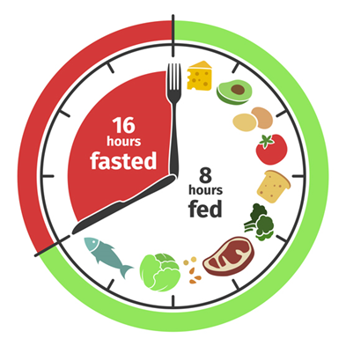

Feasibility Study of Intermittent Fasting in Chronic Lymphocytic Leukemia and Small Lymphocytic Lymphoma (CLL/SLL) Patients at BC Cancer - Victoria
Study team:
Research Lead – Eleah Stringer, MSc, RD, CSO
PI – Dr. Nicol Macpherson, Medical Oncologist
Co-Investigator – Dr. Julian Lum
Research Assistants: Nathalie Costie & Samantha Punch

Slide 2
Dual role of autophagy in cancer
In premalignant lesions, animal models suggest that autophagy might prevent cancer development by protecting cells from oxidative stress, DNA damage, inflammation and the accumulation of dysfunctional organelles (Antunes et al., 2018; Galluzzi et al., 2015).
In contrast, once cancer is established, autophagy may promote tumor cell survival and growth by allowing tumors to cope with stressors including hypoxia, nutritional and growth factor deprivation, and chemotherapy allowing the tumors to adapt, proliferate, survive and disseminate (Lum et al., 2005); Levine, Mizushima, & Virgin, 2011; Amaravadi et al., 201; White, 2012)
Notes:
In response to stress such as nutrient deprivation or hypoxia, autophagy is upregulated and functions to promote cell survival (Lum et al., 2005. In cancer cells, autophagy can have a dual role in both tumor cell survival and death.

Slide 3
Intermittent fasting, autophagy, and cancer
Limited findings however…
  Augment intracellular protein quality (Lee et al., 2014)
  Improves the maintenance of the proteome by targeting autophagy-dependent TORC1
Calorie Restriction has shown to downregulate TORC1 & upregulate autophagy in a number of tissues (Towers & Thorburn, 2016)
  Restore autophagic function & thereby preserve organelle quality (Stockman et al., 2018)

Slide 4
Autophagy Flux Data
INCLUDED: IF-002, 004, 006, 007, 009, 010, 013, 017, 018, 019, 020, 021, 022
EXCLUDED: IF-005, IF-012 (partial time points, suboptimal protein collection)
Question: does intermittent fasting upregulate autophagy in patients with CLL/SLL?

Slide 5
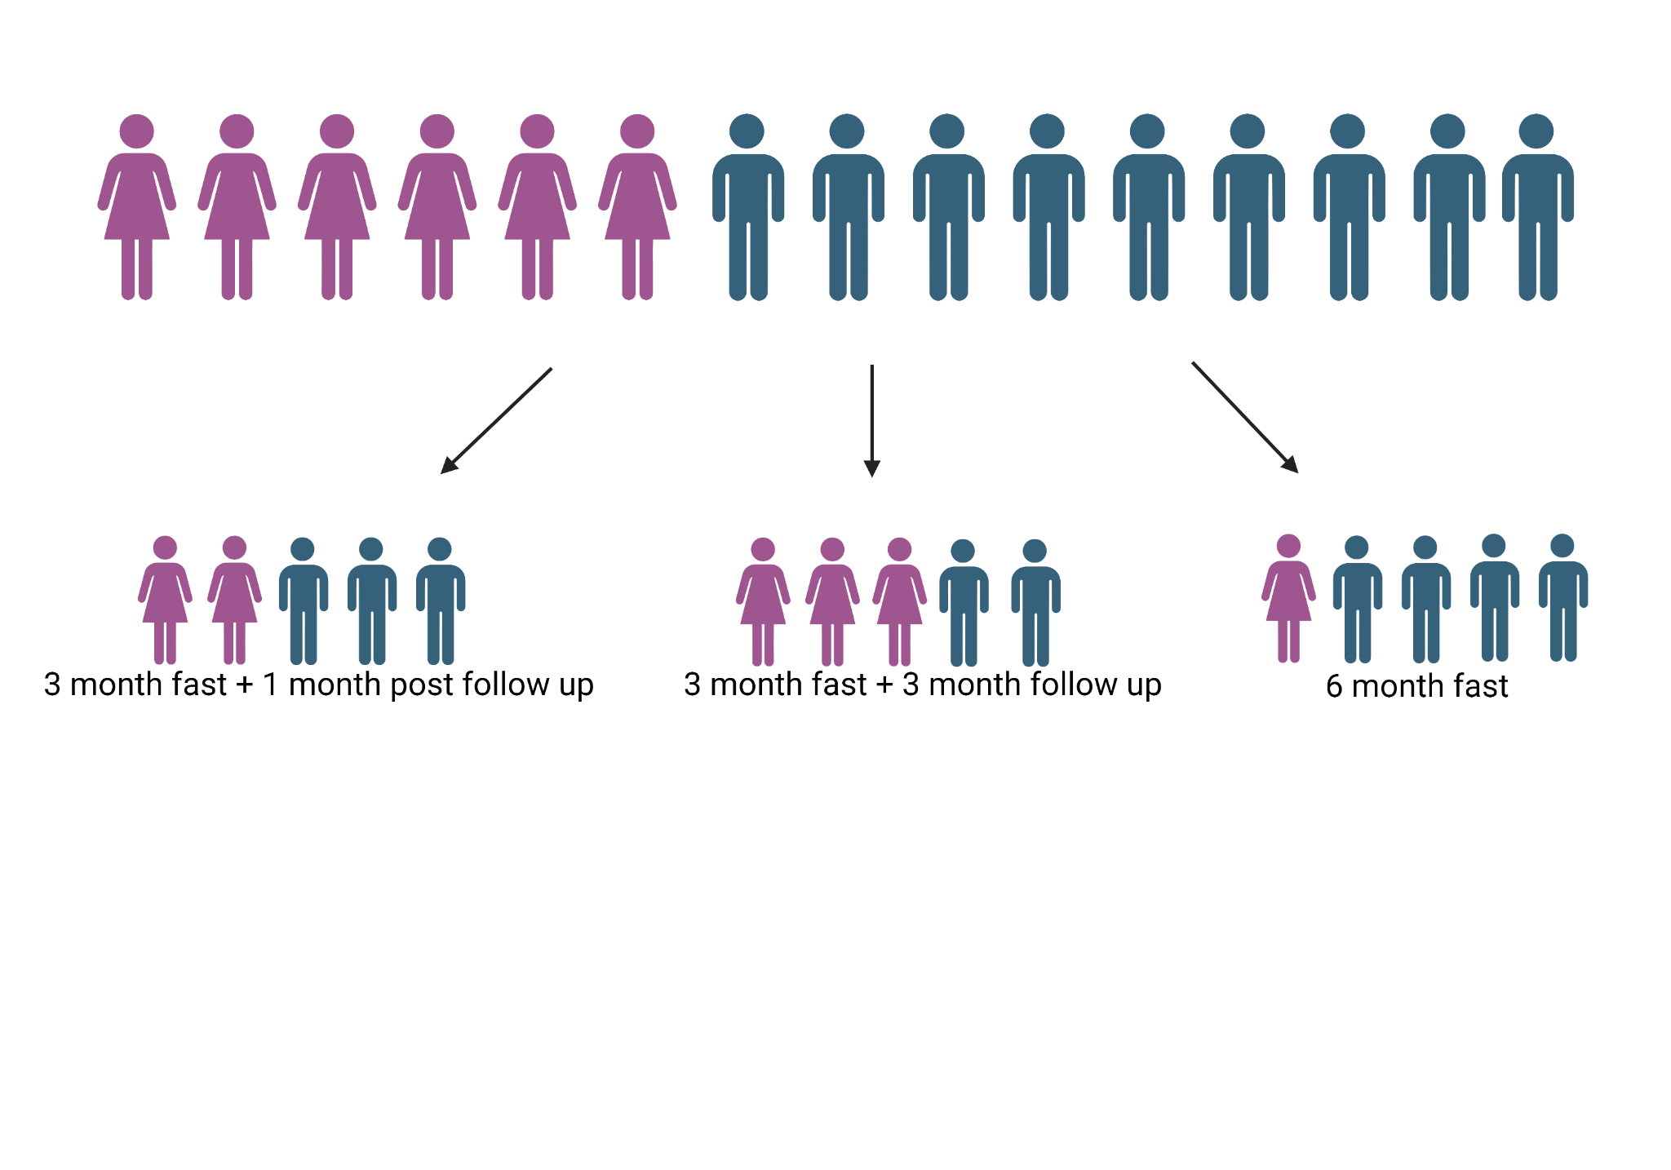
5 patients consented to the initial 4 month study
    IF-002, 004, 005, 006, 007
10 patients consented to the 6 month extension
    5 patients opted to fast for 6 months (IF-017, 019, 020, 021, 022)
    5 patients ended the fast after 90 days (IF-009, 010, 012, 013, 018)
Image created with BioRender.com
Notes:
15 patients completed the study

Slide 6
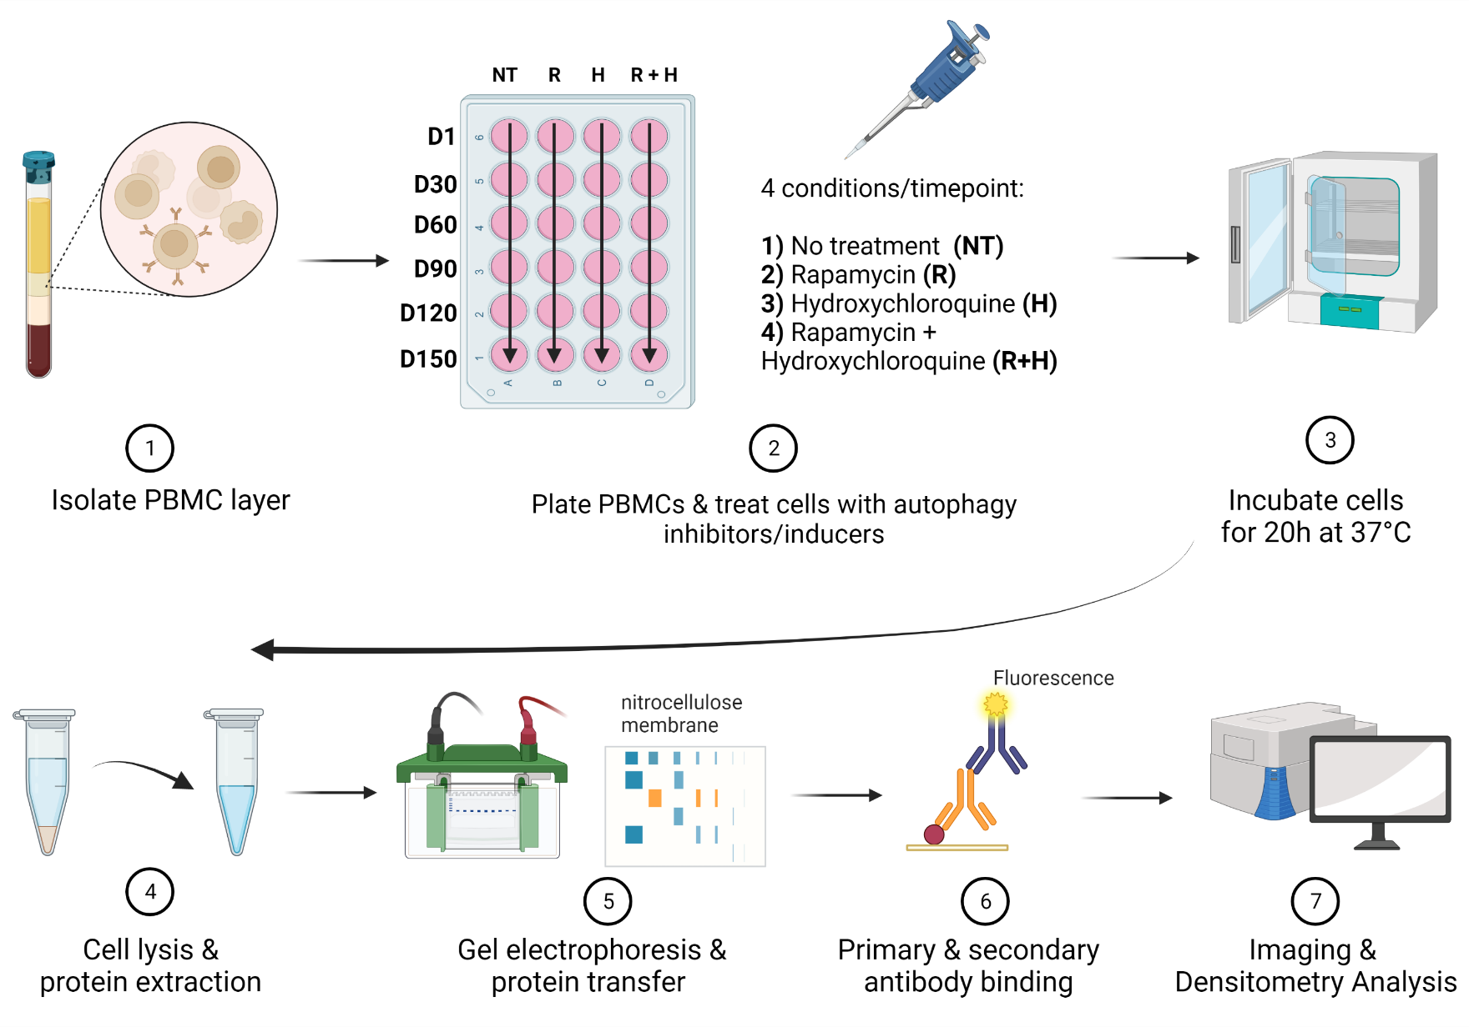
Autophagy Flux Assay Workflow
Image created with BioRender.com

Slide 7
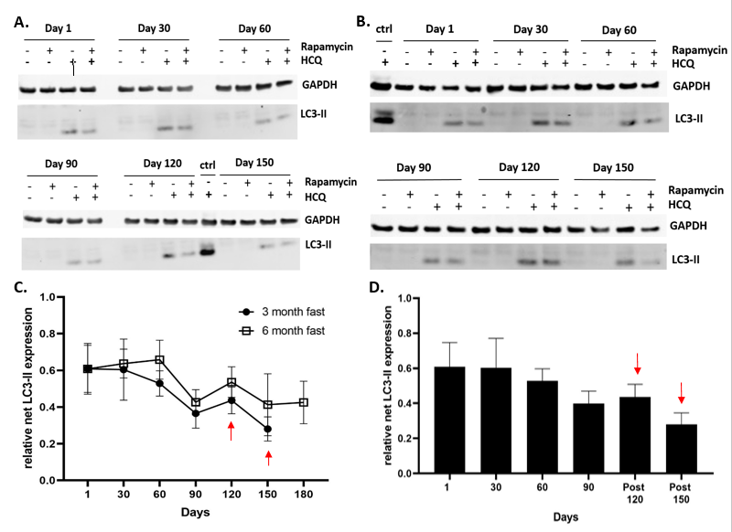
Notes:
Figure 1. Autophagy flux analysis of the 3-month and 6-month intermittent fasting diet group show decreasing levels of autophagy. Western blot analysis of (A) IF-018 (3 month fast) and (B) IF-019 (6 month fast respectively. Cells were treated with and without hydroxychloroquine (30 µM) and rapamycin (0.40 µM). LC3-II was detected using an anti-LC3B antibody and GAPDH is shown as a loading control. Positive control lysates were obtained from healthy donor PBMCs treated with hydroxychloroquine (30 µM). (C) Time course of LC3-II levels at 3 month vs. 6-month intermittent fasting groups. Data points are expressed as the mean +/- SEM of all patients in their respective group. Red arrows point to data points in the 3-month fasting group where patients are off of intermittent fasting. (D) Bar graph of 3-month intermittent fasting group with extended post-diet monitoring. Data points are expressed as the mean +/- SEM of all patients. **Day 150 (n=2)**

